Slide 1
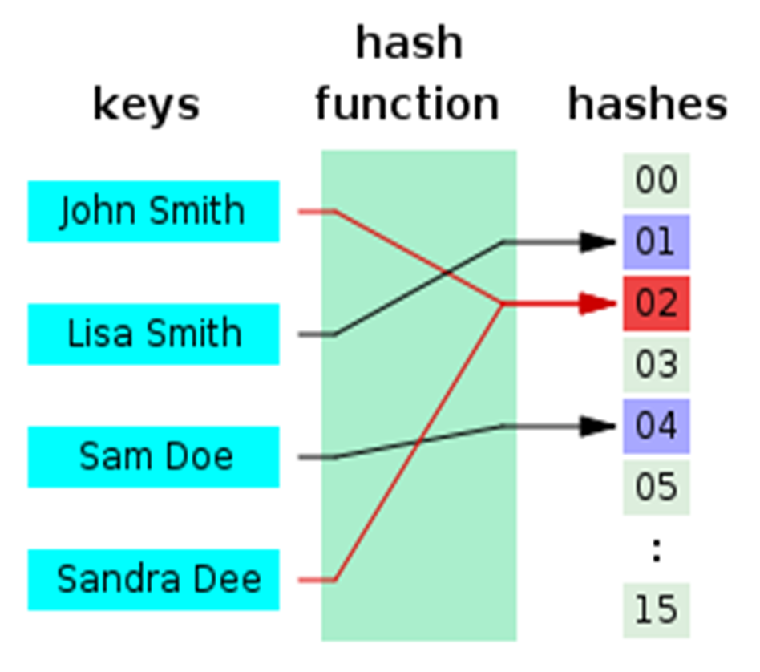
Proof-of-Work Hash Functions
ASIC-Resistant Hashes

Slide 2
Proof-of-Work Hash Functions
Blockchain proof-of-work mining uses special hash algorithms
E.g. ETHash, Equihash, CryptoNight and Cookoo Cycle
Computational-intensive and memory-intensive
Designed to be calculated on CPU and GPU, using a lot of memory
ASIC-resistant → cannot be efficiently implemented on chip
ASIC-resistant hashes → anyone can be a miner
Big number of small miners (home users) → decentralization
ASIC-friendly hashes → expensive to mine → centralization

Slide 3
ETHash
The proof-of-work hash function in the Ethereum blockchain
Memory-intensive hash-function (requires a lot of RAM to be fast)
How does ETHash work?
Seed is computed for each block (based on the entire chain)
From the seed, a 16 MB pseudorandom cache is computed
From the cache, a 1 GB dataset is extracted to be used in mining
Mining involves hashing together random slices of the dataset
* Learn more at: github.com/ethereum/wiki/wiki/Ethash, github.com/lukovkin/ethash

Slide 4
Equihash
The proof-of-work hash function in the Zcash blockchain
Memory-intensive hash-function (requires a lot of RAM to be fast)
How does Equihash work?
Uses BLAKE2b to compute 50 MB hashes from the previous blocks
Solves the "Generalized Birthday Problem" (pick 512 different strings from 2097152, such that the binary XOR of them is zero)
Double SHA256 the solution to compute the final hash
* Learn more at: https://www.cryptolux.org/images/b/b9/Equihash.pdf, https://github.com/tromp/equihash

Slide 5

Proof-of-Work Hash Functions
Learn More…
https://github.com/ifdefelse/ProgPOW

